Slide 1
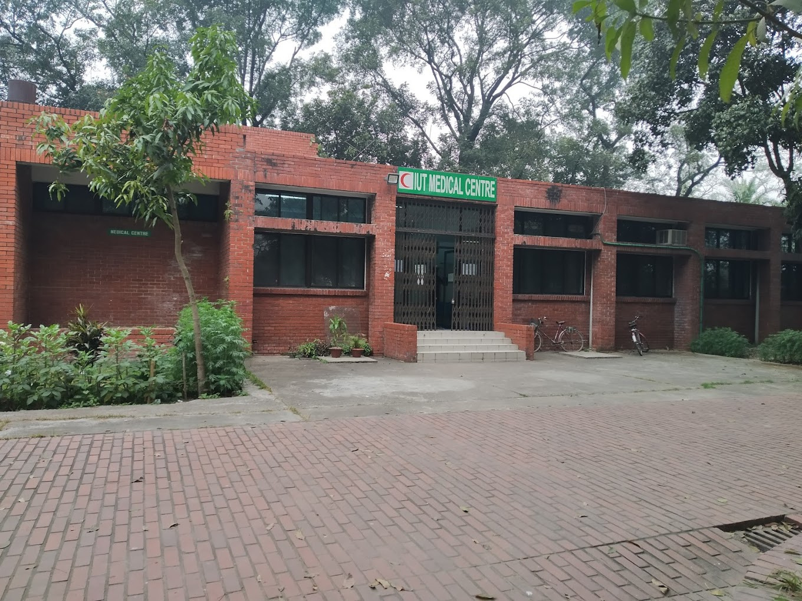

Med
iEase
IUT Medical Centre

Slide 2




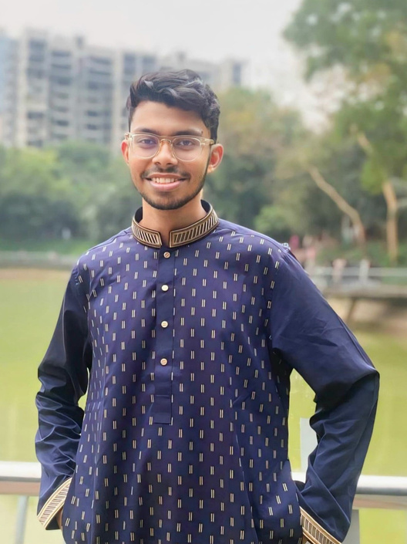
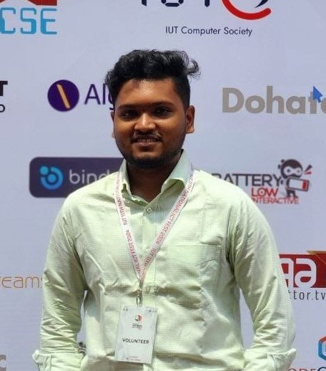
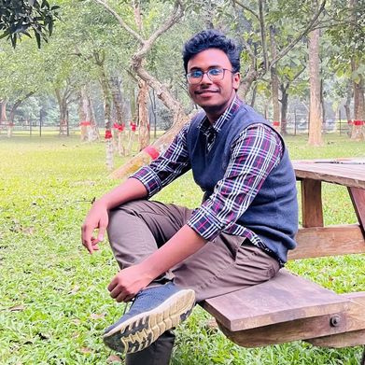
Meet T﻿eam Triple-A
SHEFAYAT E-SHAMS ADIB
AHMED ALFEY SANI
HASIN MAHTAB ALVEE
210042141
210042129
210042174

Slide 3


Comprehensive solution designed to streamline operations
Enhance patient care within the IUT Medical Centre
PROJECT
OVERVIEW
Improving operational workflows and resource management
Med
iEase

Slide 4





SITUATION ANALYSIS
Manual Record book
for each student
Hand-Written
Prescriptions
No appointment
Scheduler
No tracker
of due imbursement
Med
iEase

Slide 5



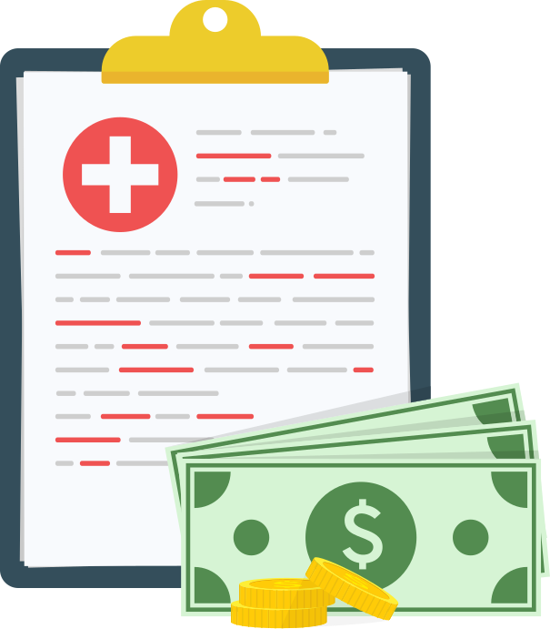



PROMISED
features
Appointment
Scheduler
Generate
Prescription
Manage
Medical Records
Due Medical Expense
Management
Service
Reservations
Staff
Scheduler
Med
iEase

Slide 6

IMPLEMENTED FEATURES
Appointment
Scheduler
Generate
Prescription
Manage
Medical Records
Staff
Scheduler
Due Medical Expense
Management
Med
iEase

Slide 7



FUTURE SCOPES
Service
Reservations
Get Referral Online
Improved Reimbursement Feature
Med
iEase

Slide 8




TOOLS AND TECHNOLOGY
Frontend
Backend
Database
IDE
Version Control
Med
iEase

Slide 9

PROJECT TIMELINE (WEEK)
Progress | 1 | 2 | 3 | 4 | 5 | 6 | 7 | 8 | 9 | 10 | 11 | 12 | 13 | 14 | 15 | 16
Problem Analysis & Requirements Gathering | ✔
System Architecture & Proposal Finalization |  | ✔
Organizing Data and Database |  |  | ✔ | ✔
Authentication and Session |  |  |  |  | ✔ | ✔
Form Validation Handling |  |  |  |  |  |  | ✔ | ✔
Admin Panel Developement |  |  |  |  |  |  |  |  | ✔ | ✔
Patient Panel Development |  |  |  |  |  |  |  |  |  |  | ✔ | ✔
Doctor Panel Development |  |  |  |  |  |  |  |  |  |  |  |  | ✔ | ✔
User Experience Improvement |  |  |  |  |  |  |  |  |  |  |  |  |  |  | ✔ | ✔
Med
iEase

Slide 10

THANKS FOR YOUR ATTENTION
ANY QUESTION?

